Slide 1
PRODUCT SALES ANALYSIS
PRESENTED BY:
SAMITHA.R

Slide 2
INTRODUCTION
product sales analysis is reviewing your sales data to identify trends and patterns .sales data can help you make better decisions about your product, pricing, promotions, inventory, customer needs other aspects of your business.
sales analysis can be as simple as reviewing your sales figures regularly. But it can also involve more complex statistical methods . Either way, the goal is to gain insight that will help you boost sales and improve your bottom line.

Slide 3
Data set:
A data set is a collection of whole data. Whether you want to work with the prediction or classification , these data sets are both intresting and helpful for machine learning projects. the data is relatively clean and lends nicely to machine learning. Plenty of variables that can help make predictions for the target column
Given data set:
DATASET LINK-
https://www.kaggle.com/datasets/ksabishek/product-sales-data

Slide 4
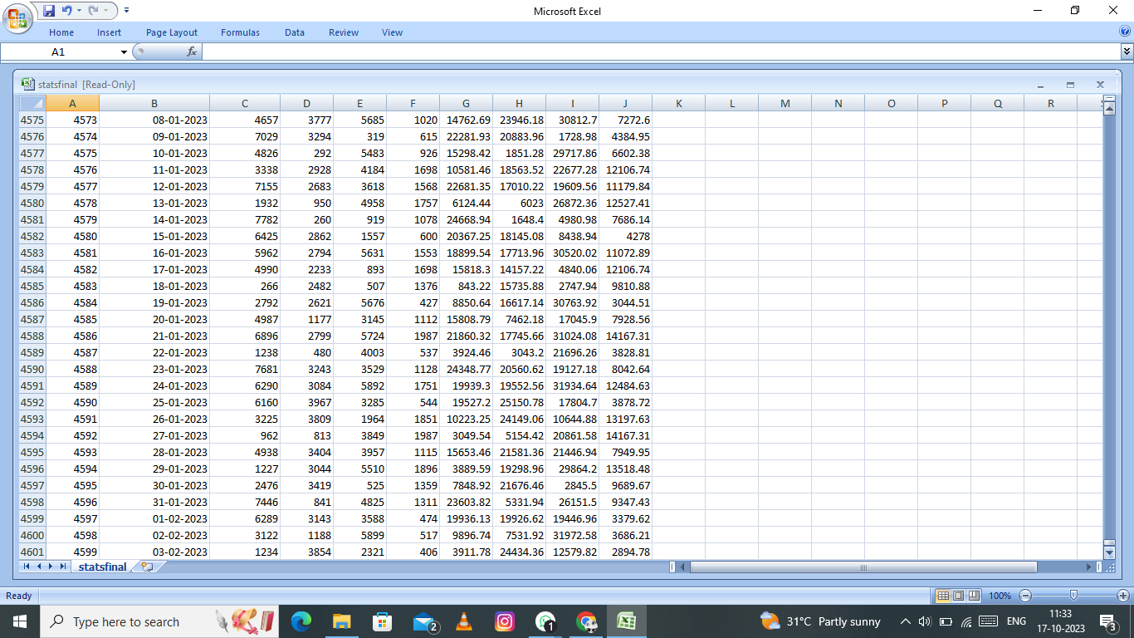
Example:

Slide 5
Necessary step to follow:
Step 1:
first we need to create a data frame of the dataset, and even before that certain libraries have to be imported.
PROGRAM:
import numpy as np
import pandas as pd
import matplotlib.pyplot as plt
Order_Details = pd.read_csv('Order_details(masked).csv')

Slide 6
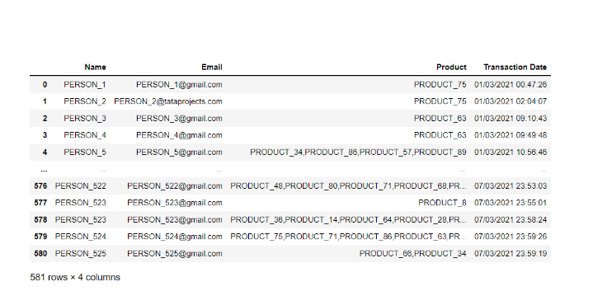
OUTPUT:

Slide 7
Step 2:
Create a new column called Time that has the DateTime format after converting the Transaction Date column into it. The DateTime format, which has the pattern YYYY-MM-DD HH:MM:SS, can be customized however you choose. Here we’re more interested in obtaining hours, so we can have an Hour column by using an in-built function for the same:
PROGRAM:
# here we have taken Transaction
# date column
Order_Details['Time'] = pd.to_datetime(Order_Details['Transaction Date'])
# After that we extracted hour
# from Transaction date column
Order_Details['Hour'] = (Order_Details['Time']).dt.hour

Slide 8
Step 3:
We then require the “n” busiest hours. For that, we get the first “n” entries in a list containing the occurrence rates of the hours when the transaction took place. To further simplify the manipulation of the provided data in Python, we may utilize value counts for frequencies and tolist() to convert to list format. We are also compiling a list of the associated index values.
PROGRAM:
# n =24 in this case, can be modified
# as per need to see top 'n' busiest hours
timemost1 = Order_Details['Hour'].value_counts().index.tolist()[:24]
timemost2 = Order_Details['Hour'].value_counts().values.tolist()[:24]

Slide 9
Step 4:
Finally, we stack the indices (hour) and frequencies together to yield the final result.
PROGRAM
import matplotlib.pyplot as plt
fig=plt.figure()
ax=fig.add_axes([0,0,1,1])
products=['grocery','vegetables','cosmetics','fruits','home expenditure']
productsold=[81,11,0,42,58]
ax.bar(products,productsold)
plt.show

Slide 10
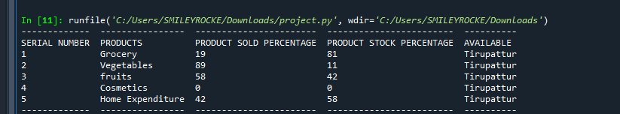
OUTPUT:

Slide 11
Step 6:
For data visualization, we will proceed with Matplotlib for better comprehensibility, as it is one of the most convenient and commonly used libraries. But, It is up to you to choose any of the pre-existing libraries like Matplotlib, Ggplot, Seaborn, etc., to plot the data graphically.
PROGRAM:
import matplotlib.pyplot as plt
fig=plt.figure()
ax=fig.add_axes([0,0,1,1])
products=['grocery','vegetables','cosmetics','fruits','home expenditure']
productsold=[19,89,0,58,42]
ax.bar(products,productsold)
plt.show

Slide 12
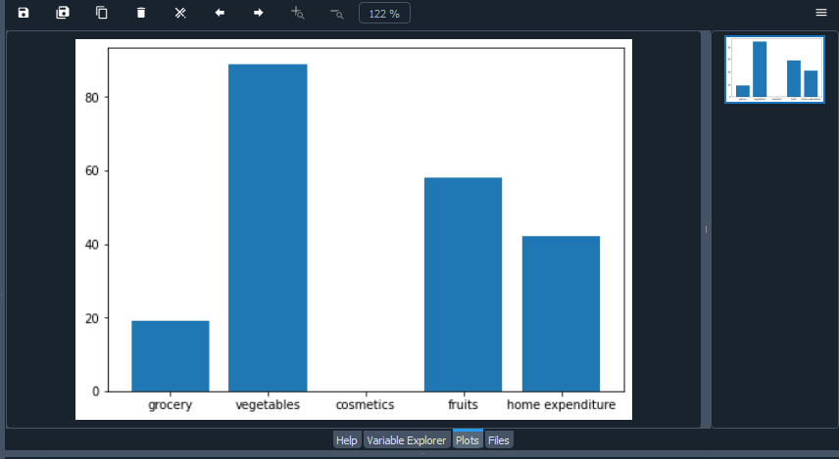
OUTPUT:

Slide 13
PROGRAM:
import matplotlib.pyplot as plt
fig=plt.figure()
ax=fig.add_axes([0,0,1,1])
products=['grocery','vegetables','cosmetics','fruits','home expenditure']
productsold=[81,11,0,42,58]
ax.bar(products,productsold)
plt.show

Slide 14
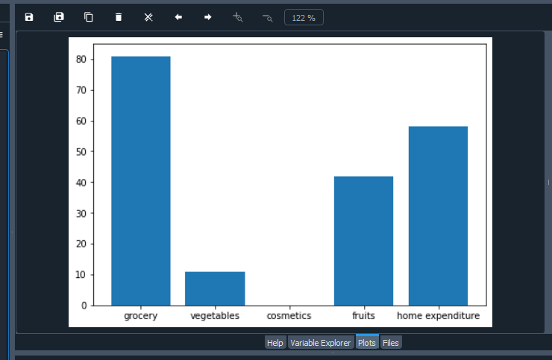
OUTPUT:

Slide 15
SALES REPORTING:
Sales reporting is the summarizing information about sales. Companies often use sales reporting to track sales progress and to communicate with inventors executives.
For example
They may report monthly sales figures to shareholders so that investors can better understand hoe their investments are performing.

Slide 16
CONCLUSION
The results are indicative of how sales typically peak in groceries prominently, and this data can be incorporated into business decisions to promote a grocery product specifically.

